Slide 1
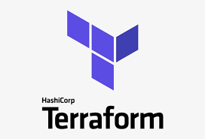
UNIT 1
INTRODUCTION TO TERRAFORM
Notes:
1

Slide 2

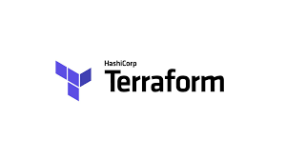
Introduction to Terraform
Introduction to Terraform
Infrastructure Automation
Install Terraform
Providers
Resources
Basic Syntax

Slide 3
Introduction
It is a HASHI CORP Product.
It’s a tool for building, changing, and versioning infrastructure.
Configuration files describe to Terraform the components needed to run
Terraform generate an execute plan describing what it will do to reach the desired state and then executes it
It is used to define & provision complete Infra using easy to learn declarative language(HCL)
You can store your cloud infra setup as code
Designed by Mitchell Hashimoto, backend coding using GO language in 28th July 2014 Introduced as a Enterprise solution. Its Opensource

Slide 4
Infrastructure as a Code
Infrastructure as code (IaC) tools allow you to manage infrastructure with configuration files rather than through a graphical user interface.
IaC allows you to build, change, and manage your infrastructure in a safe, consistent, and repeatable way by defining resource configurations that you can version, reuse, and share.
Terraform is HashiCorp’s infrastructure as code tool. It lets you define resources and infrastructure in human-readable, declarative configuration files, and manages your infrastructure’s lifecycle.

Slide 5
Infrastructure as a Code
Terraform plugins called providers let Terraform interact with cloud platforms and other services via their application programming interfaces (APIs).
Providers define individual units of infrastructure, into reusable Terraform configurations called modules, and manage them with a consistent language and workflow.

Slide 6
Infrastructure as a Code
Provisioning Infrastructure through software to achieve consistent and predictable environments
Core concept:
Defined in code
Stored in source control
Declarative or Imperative
Idempotent and consistent
Push or pull
Is Terraform push or pull?
The terraform state push command is used to manually upload a local state file to remote state. This command also works with local state.
The terraform state pull command is used to manually download and output the state from remote state.

Slide 7
Infrastructure as a Code
Benefits:
a) Automated deployment
b) Provisioning Consistent environments
c) Repeatable process
d) Reusable components
e) Documented architecture
f) Infrasturcture Lifecycle

Slide 8
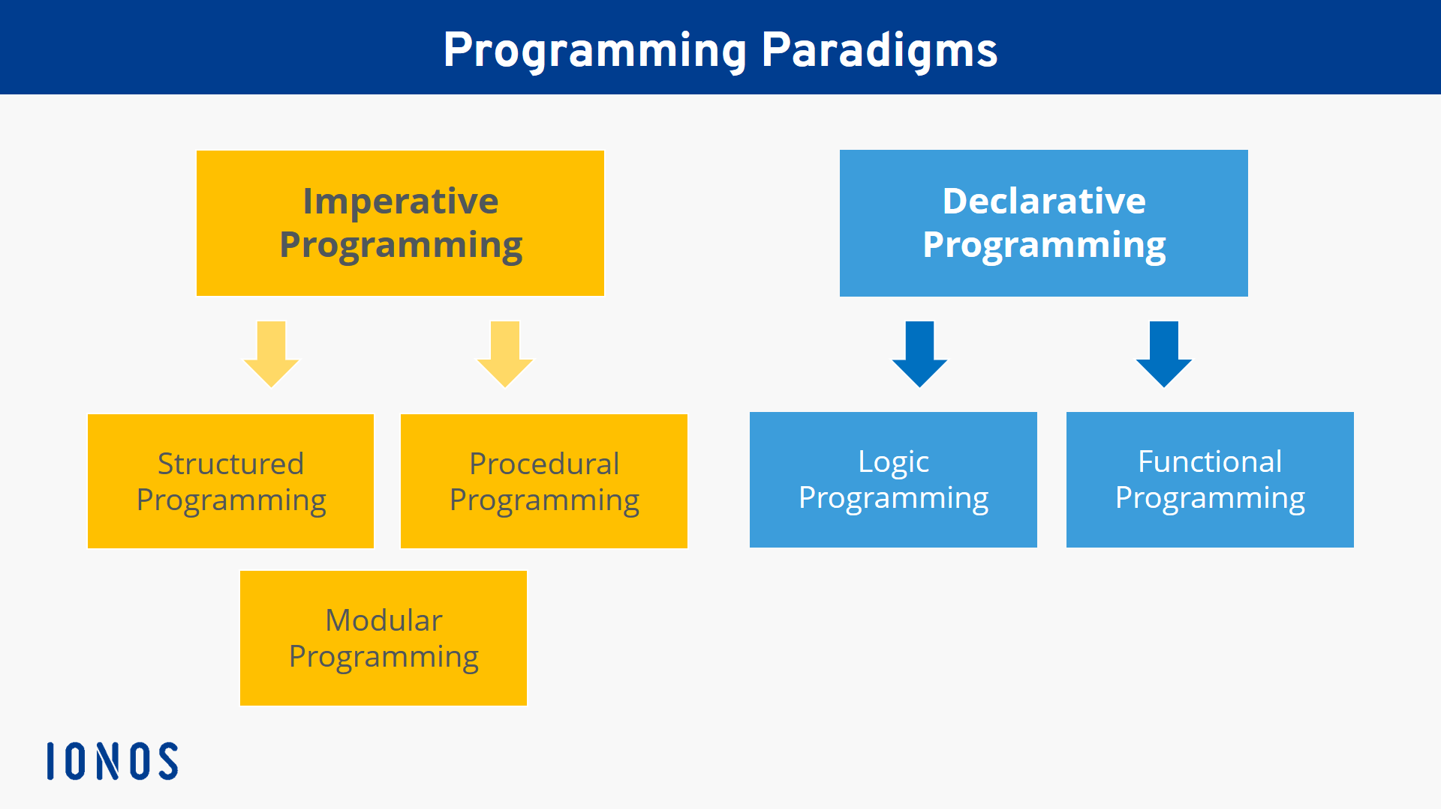
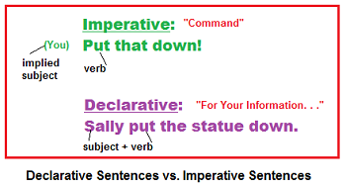
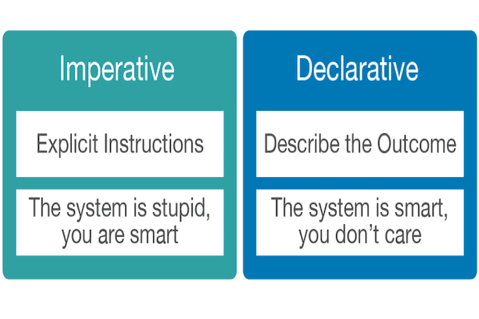
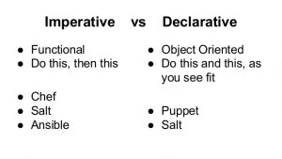
Infrastructure as a Code
expresses the logic of a computation without describing its control flow
uses statements that change a program's state.

Slide 9
Declarative & Imperative
Declarative – Functional Approch
You specify the desired state (Final State) of Infra you want to Provision & IAC Software will handle the rest
Eg. Spinning of VM or container, Installing & configuring the necessary software, resolving system & Software dependencies and Versioning
Need skilled administrator to setup
Instead of explicitly outling the sequeance of steps shows Final result
Imperative– Procedural Approach
Helps you prepare automation script, one specific step at a time
It gives orders, defines sequence of commands or instruction so infra reach the final result.

Slide 10
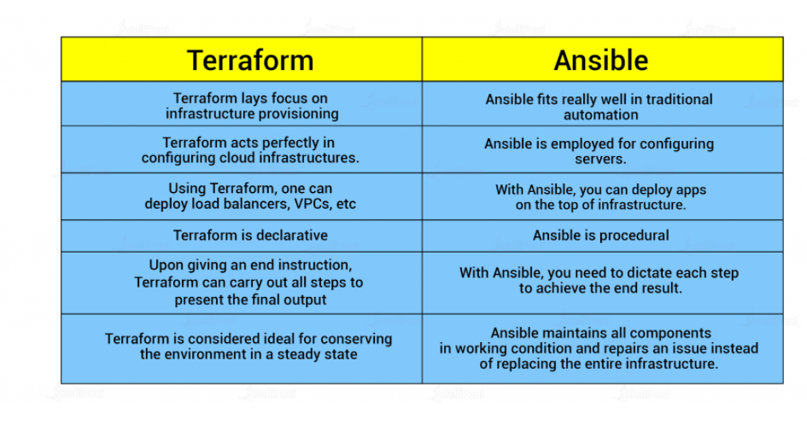
Infrastructure as a Code

Slide 11
Infrastructure as a Code
Orchestration - ensures the right number of instruments are there and that all of them are playing correctly. If there is an issue, an orchestration tool will generally remove the misbehaving instrument and replace it with another. Orchestration tools are usually focused on the end result and help to ensure the environment is always in that “state”.
Configure management - configure each instrument to ensure it is on key, free of damage, and is working properly. If there is a problem with an instrument, the CM tool will work to repair the issue rather than just replace the instrument entirely.

Slide 12
Plugin
External Binaries that Terraform uses to access and manipulate Resources
Terraform Automatically discovers Providers requirements from your configuration
Providers such as AWS,Azure, GCp etc
Authentication with Infra Provider
Define Resouces that map the specific Services
Immutable infrastructure is an approach to managing services and software deployments on IT resources wherein components are replaced rather than changed
Mutable infrastructure is IT server infrastructure that is capable of being modified and updated in-place on a regular basis.

Slide 13
Module : A Terraform module allows you to create logical abstraction on the top of some resource set. In other words, a module allows you to group resources together and reuse this group later, possibly many time
Resources are the most important element in the Terraform language. Each resource block describes one or more infrastructure objects, such as virtual networks, compute instances, or higher-level components such as DNS records. Resource Blocks documents the syntax for declaring resources.
Terraform builds a dependency graph from the Terraform configurations, and walks this graph to generate plans, refresh state, and more. This page documents the details of what are contained in this graph, what types of nodes there are, and how the edges of the graph are determined. Terraform builds a graph of all your resources and parallelizes the creation and modification of any non-dependent resources. Because of this, Terraform builds infrastructure as efficiently as possible, and operators get insight into dependencies in their infrastructure.

Slide 14
Terraform INIT
Command to initiaze the working Directory that contains your code.
Download all Plugin & Modules
Create a backend files

Slide 15
Terraform PLAN
After Initialization, Terraform Plan with Read the code and the create and shows a plan of Deployment
It allows users to review Action Plan before executing anything
At this stage, authentication credentials are used to connect to your infrastructure.
Will tell how many resources you have added, changed & destroyed
Terraform Plan doesn’t change , update or deploy anything, it just show what is going to deploy.
Reads the current state of the existing remote objects to ensure that the state is up to date.

Slide 16
Terraform APPLY
Deploy the infrastructure as defines in a plan & infrastructure comes to desired state.
If you have Deployed deployment, if you make change in the file, it will update the Deployment state. It is used to create a new deployment as will as existing Deployment.
Potentially changes the configuration

Slide 17
Terraform Destroy
Terrafrom Destroy will read the state file created during deployment and destroy all resources found in state file
Should be used carefully, as this is non-reversible.
It will destroy all resources Or instances created using terraform apply.

Slide 19
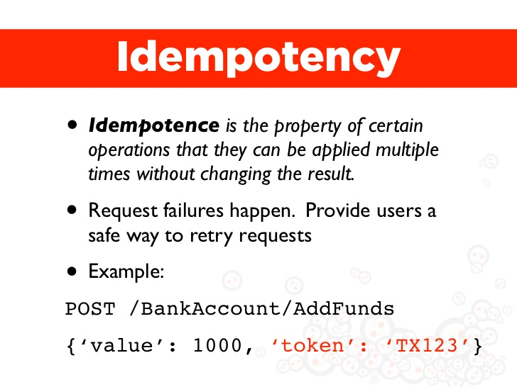
Infrastructure as a Code

Slide 20
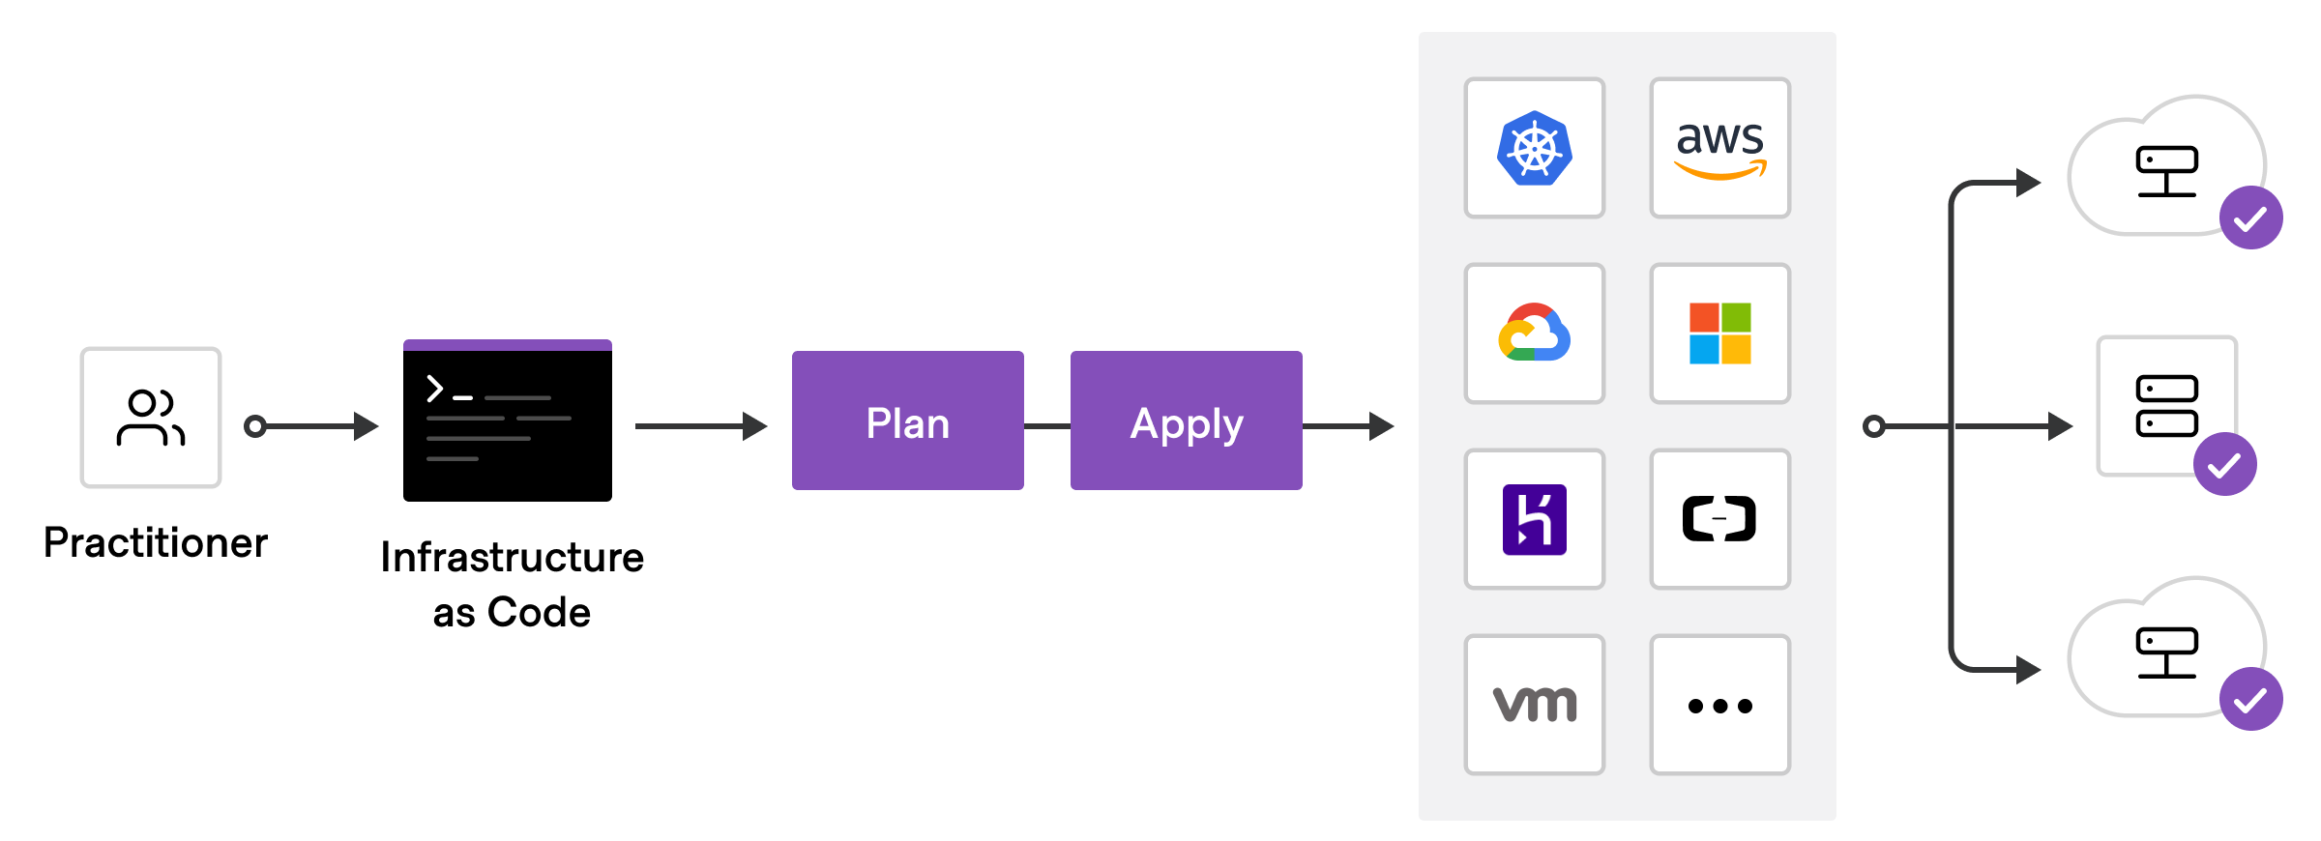
Infrastructure as a Code

Slide 21
Infrastructure as a Code
To deploy infrastructure with Terraform:
Scope - Identify the infrastructure for your project.
Author - Write the configuration for your infrastructure.
Initialize - Install the plugins Terraform needs to manage the infrastructure.
Plan - Preview the changes Terraform will make to match your configuration.
Apply - Make the planned changes.

Slide 22
Terraform components
Terraform executable
Terraform files
Terraform plugins
Terraform state

Slide 23
Installation
Install basic packages:
sudo apt-get update && sudo apt-get install -y gnupg software-properties-common curl
Add HashiCorp GPG Key:
curl -fsSL https://apt.releases.hashicorp.com/gpg | sudo apt-key add -

Slide 24
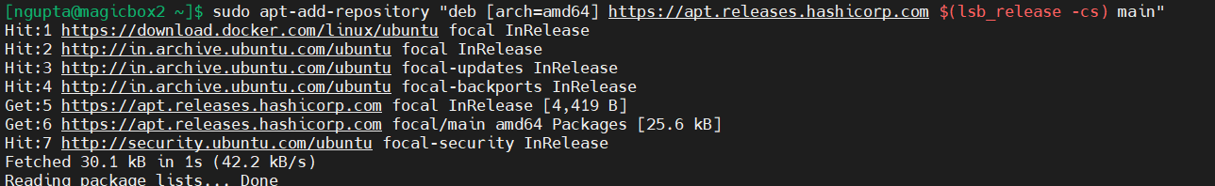
Installation
Add Linux repository
sudo apt-add-repository "deb [arch=amd64] https://apt.releases.hashicorp.com $(lsb_release -cs) main"

Slide 25
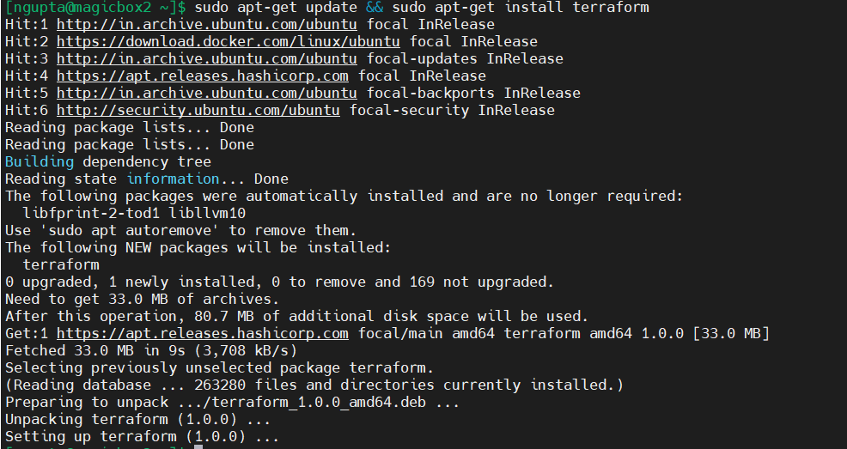
Installation
Update and Install Terraform CLI
sudo apt-get update && sudo apt-get install terraform

Slide 26
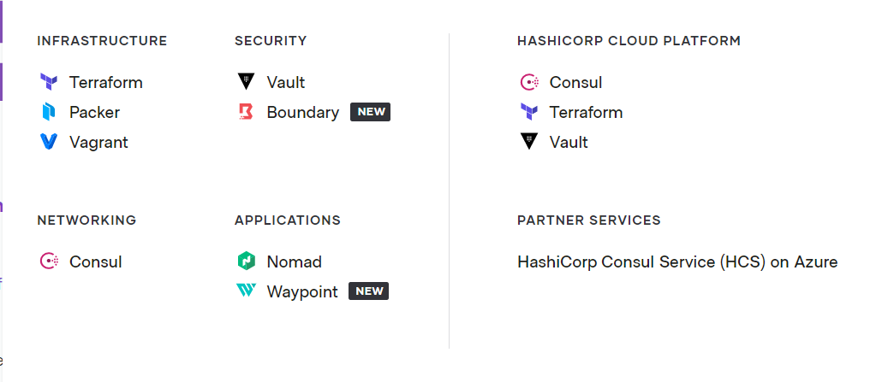
Other Products

Slide 27
Providers
Each provider adds a set of resource types and/or data sources that Terraform can manage. Every resource type is implemented by a provider; without providers, Terraform can't manage any kind of infrastructure. Most providers configure a specific infrastructure platform (either cloud or self-hosted).

Slide 29
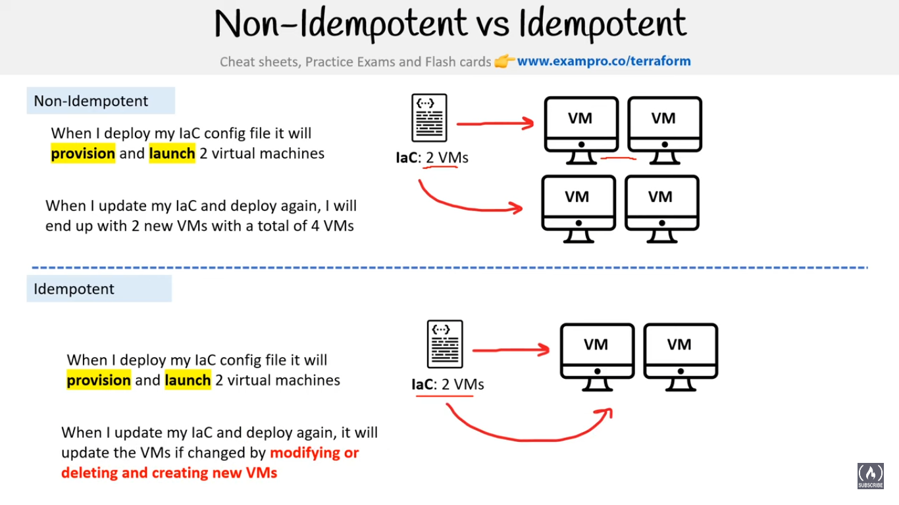

Slide 30
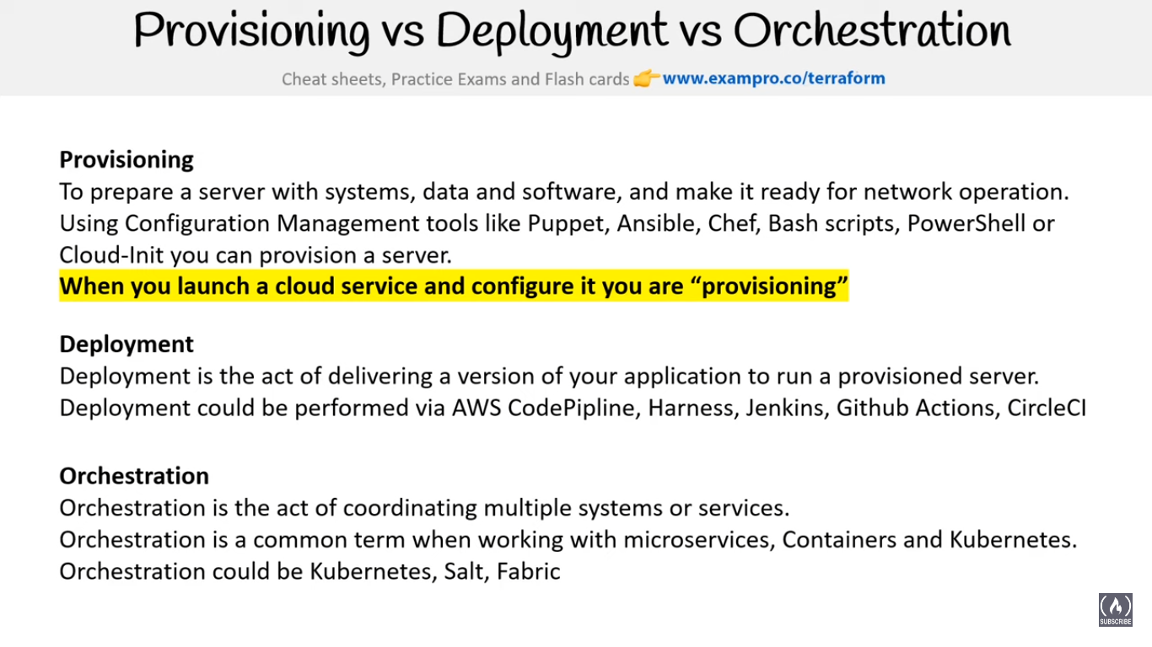

Slide 31
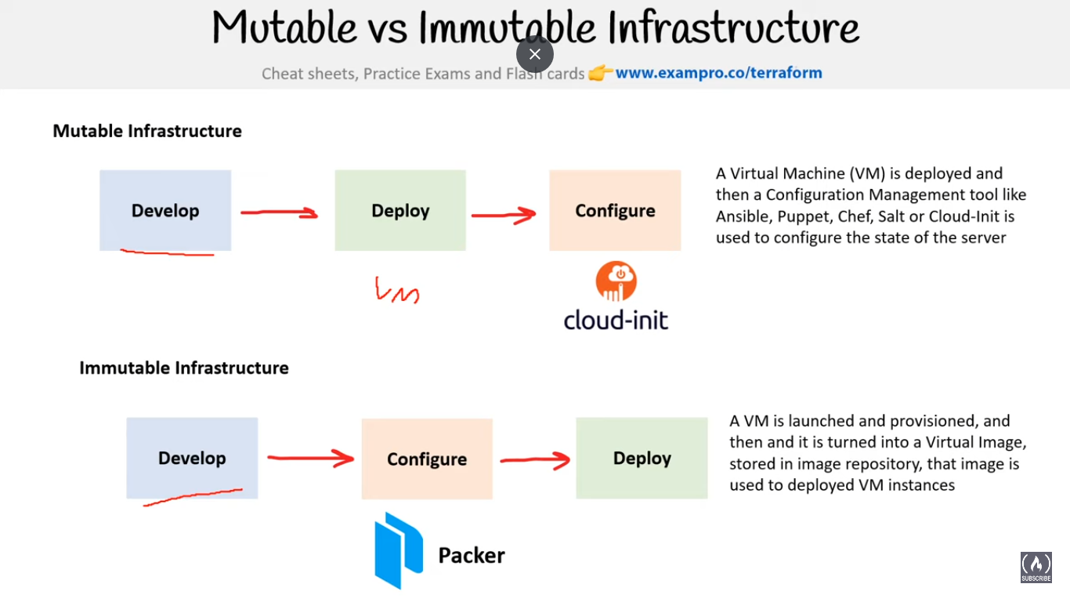

Slide 32
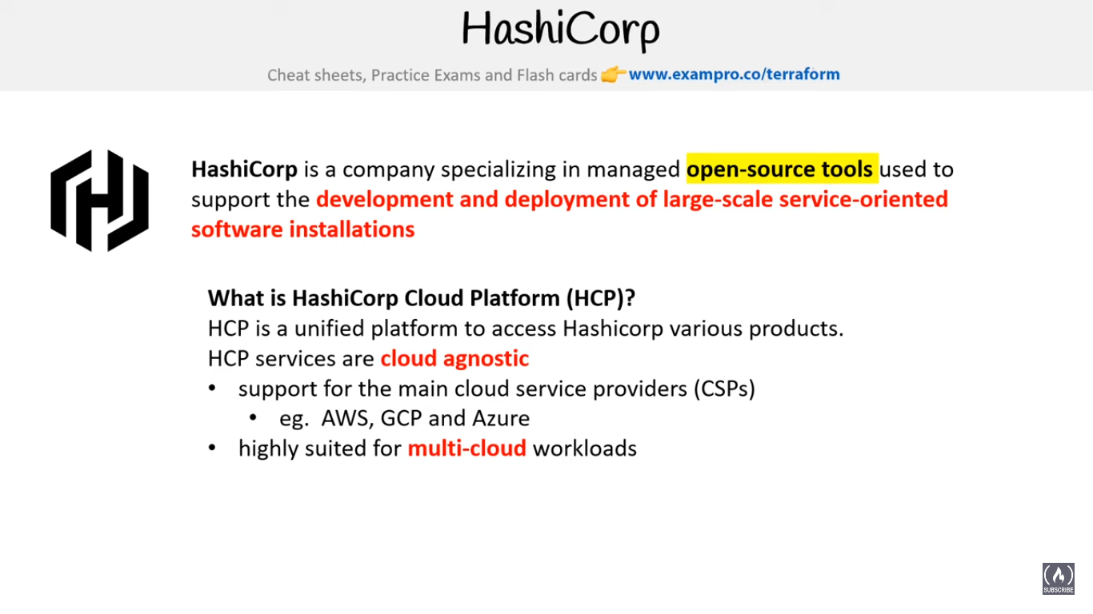

Slide 33
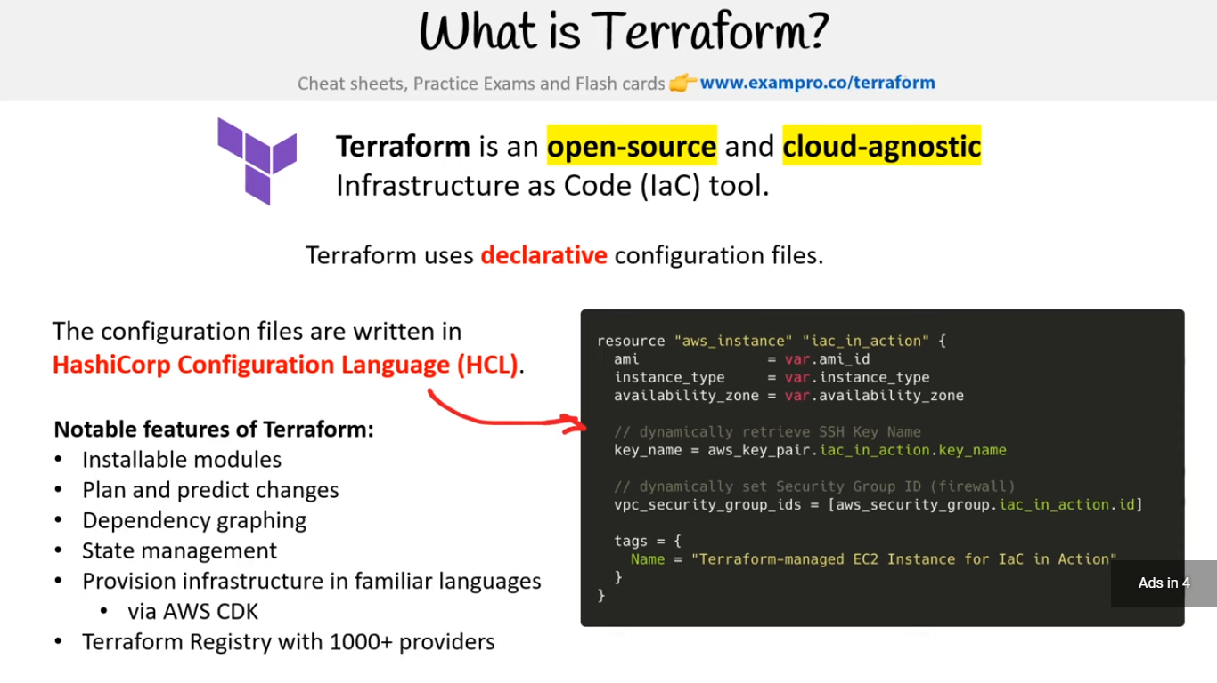

Slide 34
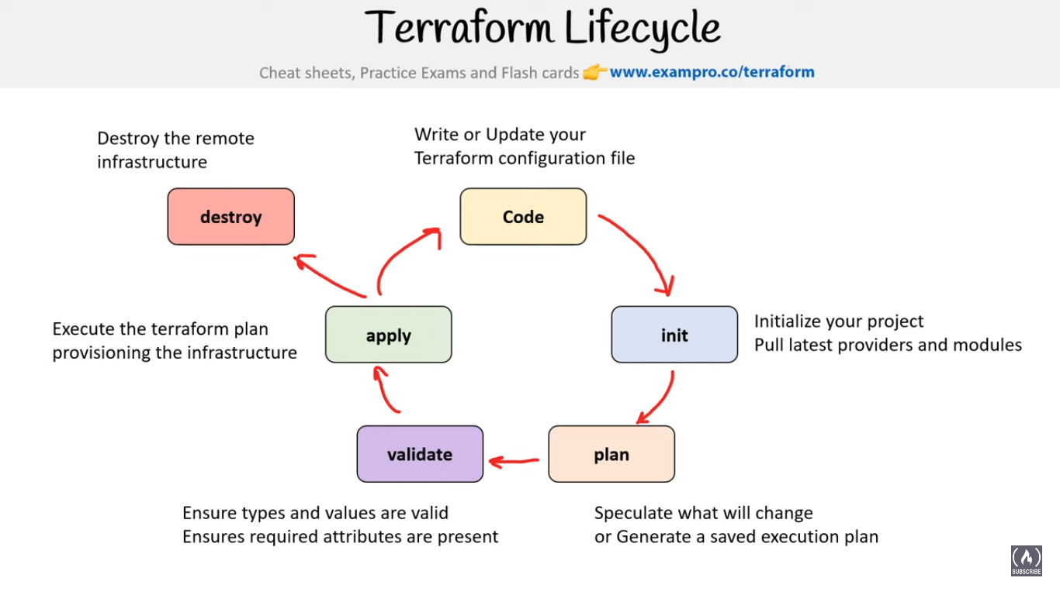

Slide 36
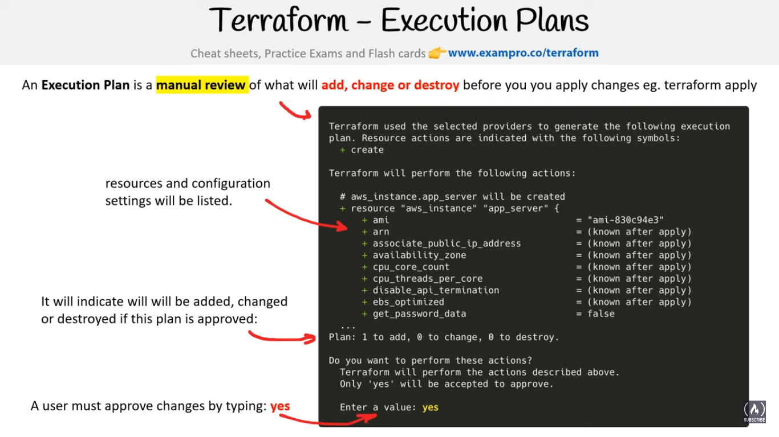

Slide 37
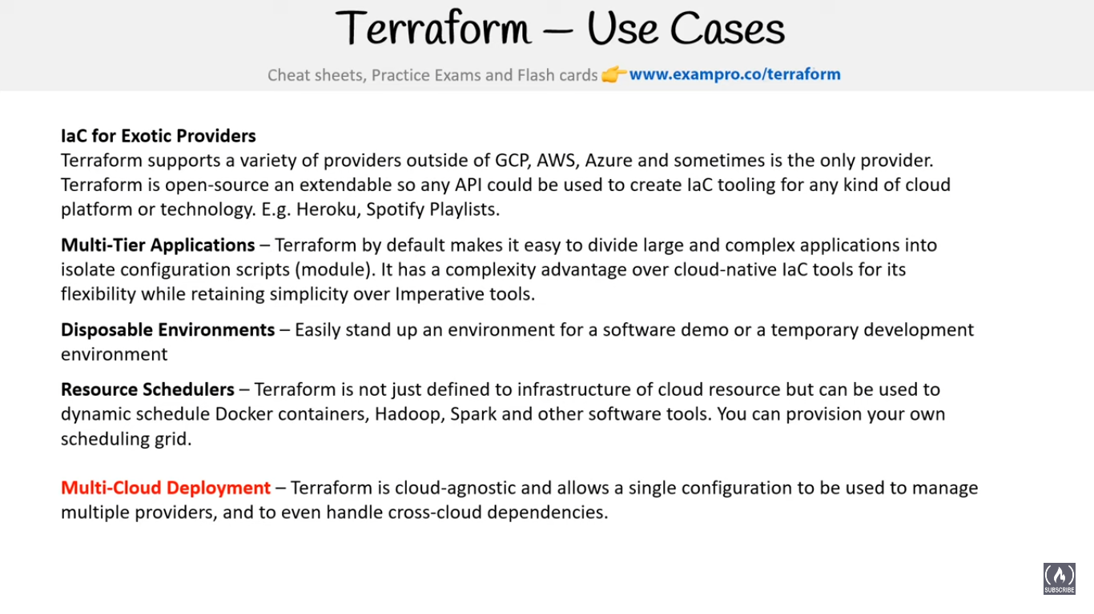

Slide 38
Resource
Resources are the most important element in the Terraform language. ... Each resource block describes one or more infrastructure objects, such as virtual networks, compute instances, or higher-level components such as DNS records. Resource Blocks documents the syntax for declaring resources.

Slide 39
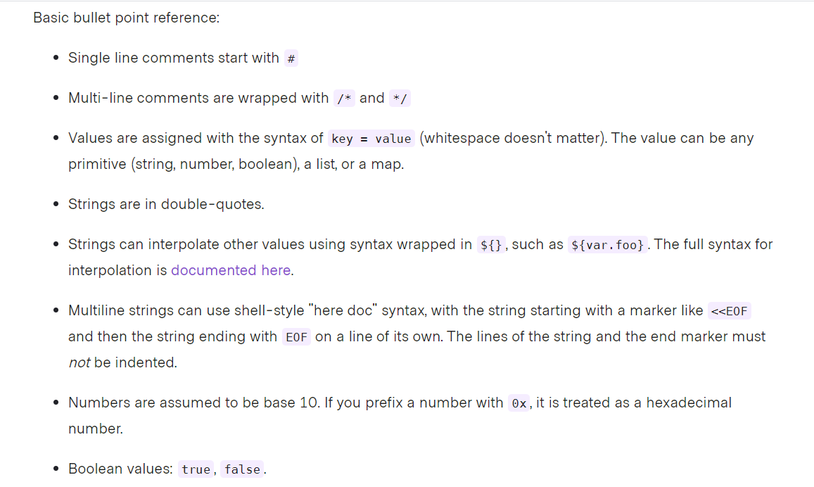
Basic Syntax

Slide 40
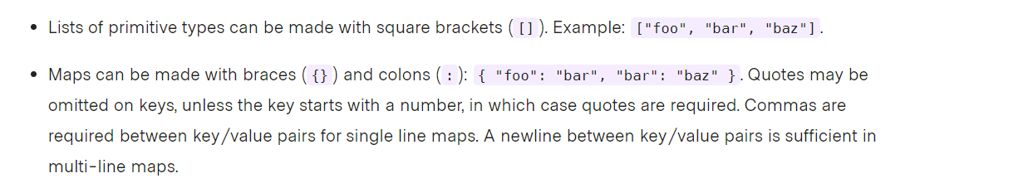
Basic Syntax
Terraform also supports reading JSON formatted configuration files.
https://www.terraform.io/docs/language/syntax/configuration.html
https://www.terraform.io/docs/language/index.html

Slide 41
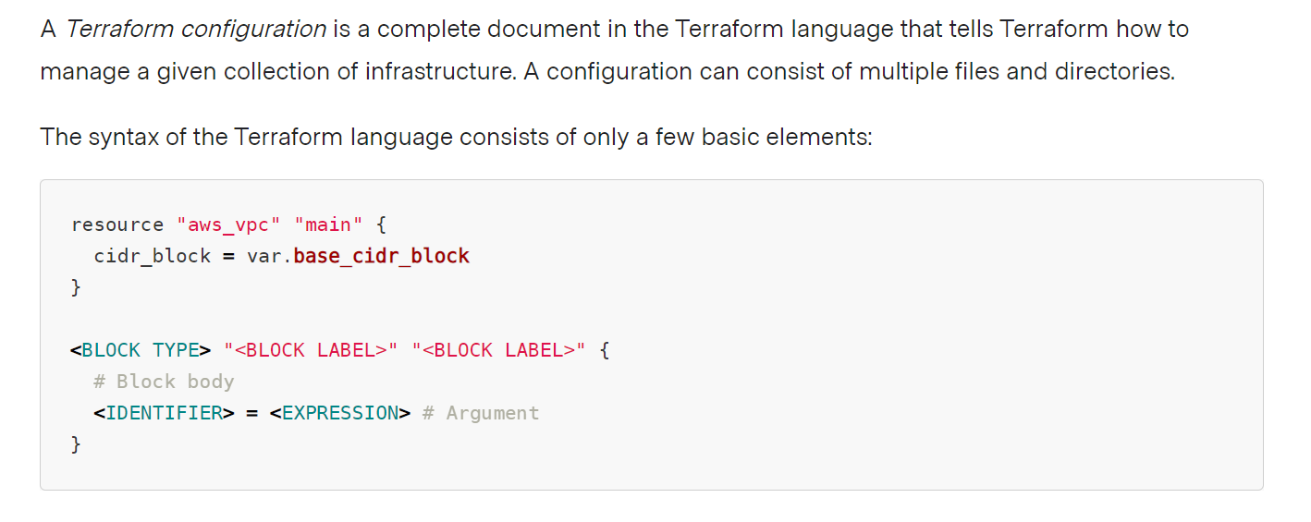
Basic Syntax

Slide 42
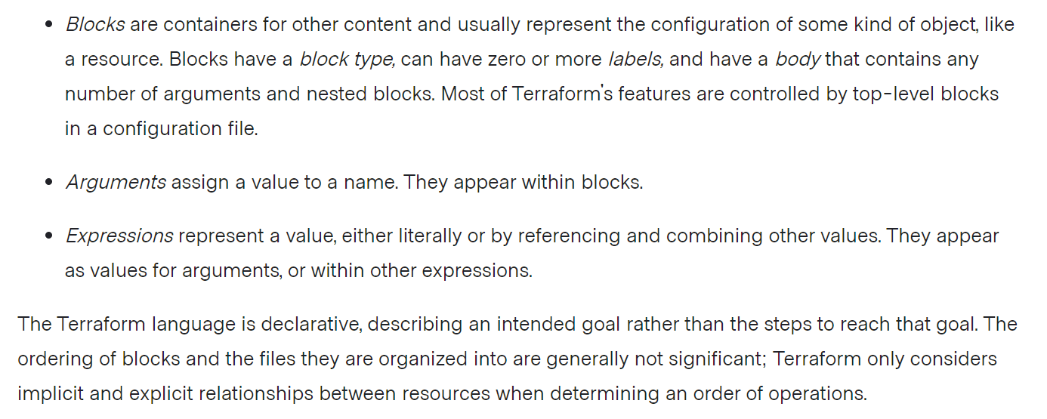
Basic Syntax

Slide 43
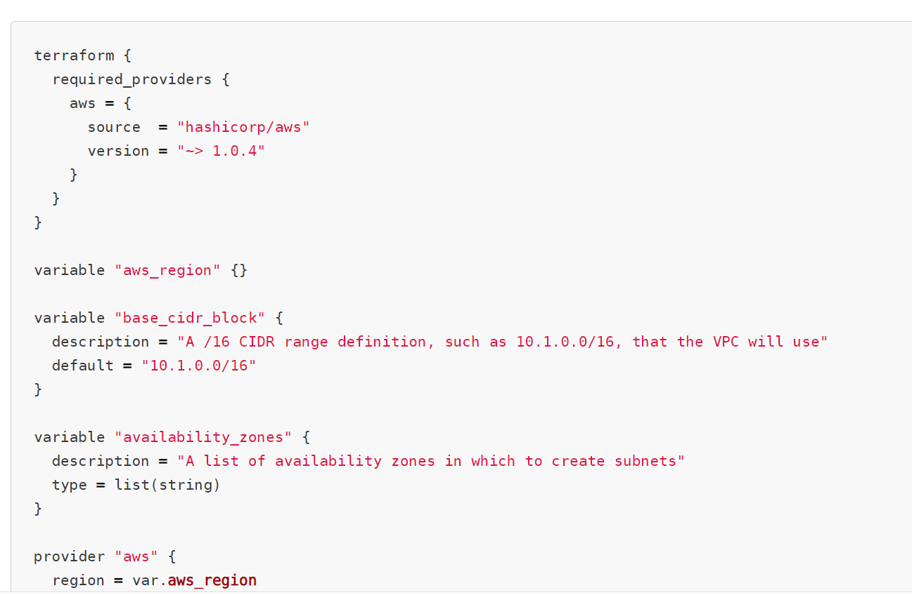
Basic Syntax

Slide 44
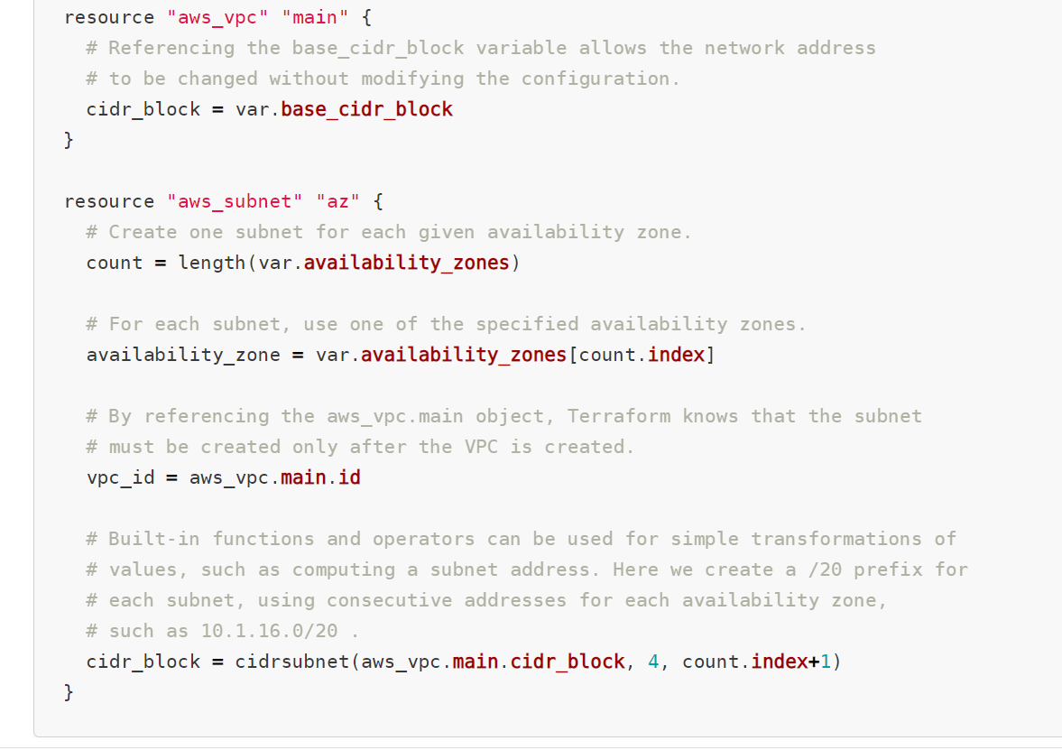
Basic Syntax

Slide 45
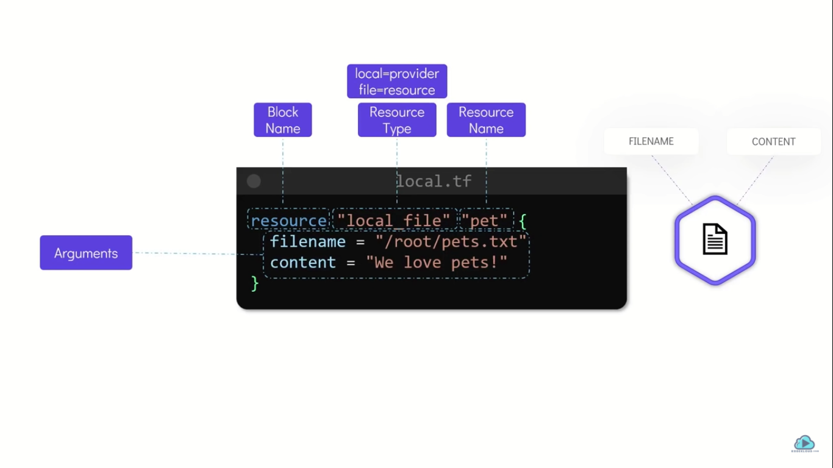

Slide 46
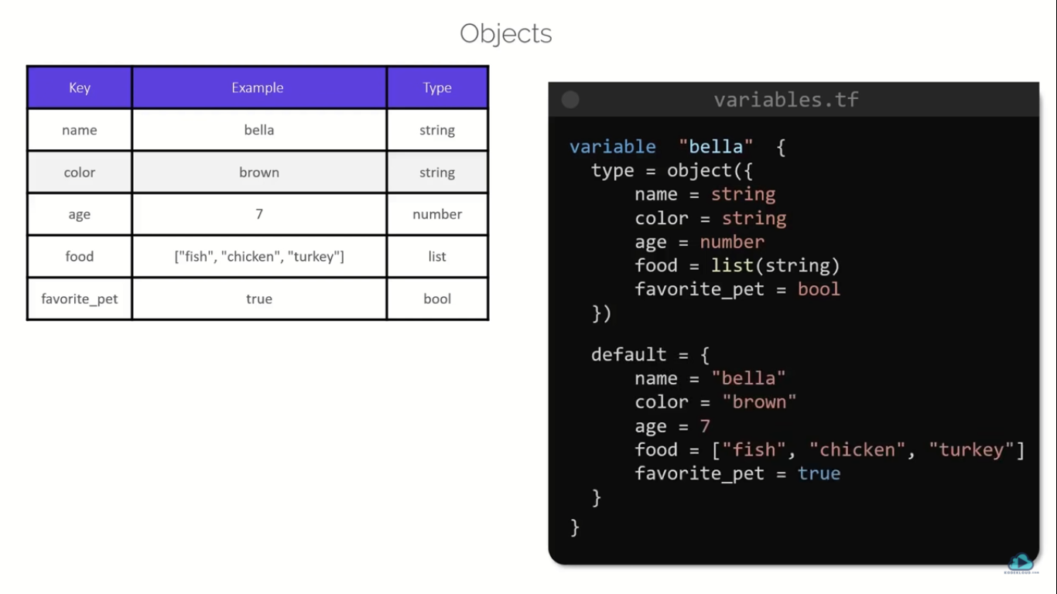

Slide 47
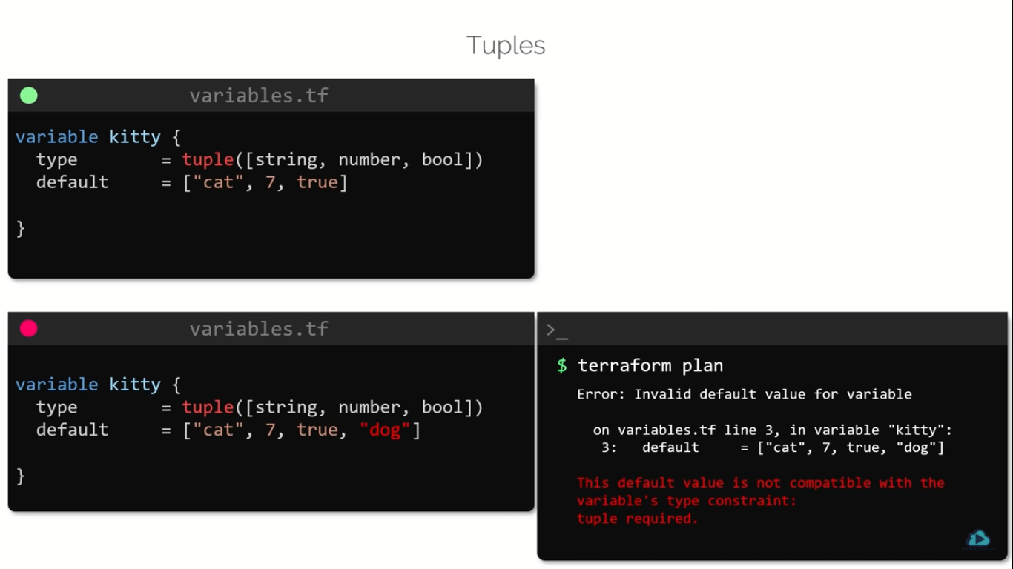

Slide 48
Imperative Programming | Declarative Programming
In this, programs specify how it is to be done. | In this, programs specify what is to be done.
It simply describes the control flow of computation. | It simply expresses the logic of computation.
Its main goal is to describe how to get it or accomplish it. | Its main goal is to describe the desired result without direct dictation on how to get it.
Its advantages include ease to learn and read, the notional model is simple to understand, etc. | Its advantages include effective code, which can be applied by using ways, easy extension, high level of abstraction, etc.
Its type includes procedural programming, object-oriented programming, parallel processing approach. | Its type includes logic programming and functional programming.
In this, the user is allowed to make decisions and commands to the compiler. | In this, a compiler is allowed to make decisions.
It has many side effects and includes mutable variables as compared to declarative programming. | It has no side effects and does not include any mutable variables as compared to imperative programming.
It gives full control to developers that are very important in low-level programming. | It may automate repetitive flow along with simplifying code structure.

